Slide 1
Splitting Tuples of Mismatched Entities
Wenfei Fan Ziyan Han Weilong Ren* Ding Wang
Yaoshu Wang Min Xie Mengyi Yan
Notes:
Good afternoon, everyone.
My name is Ziyan Han, from Beihang University.
Today, I will introduce our work about splitting tuples of mismatched entities.

Slide 2
Background: Rules are Vital in Data Management
Data Quality Rules: Functional Dependencies (FDs), Conditional Functional Dependencies (CFDs), Denial Constraints (DCs), Matching Dependencies (MDs), Entity Enhancing Rules (REEs), etc.
Rule Discovery:
Domain Experts $−$ write/discover rules manual $−$ high cost
Automatic rule discovery $−$ faces challenges such as large data, complex rules, etc.
Rule Applications:
Conflict Resolution (CR): Detect/correct inconsistencies and missing values.
Entity Resolution (ER): Eliminate redundancy and consolidate identical entities.
Tuple Splitting (TS): Fix incorrectly merged tuples and redistribute attributes.
Notes:
Rules play a critical role in many aspects of data management

Slide 3
Motivation – A Real Mismatch Example
information from the Swiss director
information from the German director
erroneous values
tid | name | nationality | born | college | film | filmFestival | festCity | festCountry
t_{s} | Noemi Schneider | Swiss | 2013 | null | Sturm | DOK.fest | Munich | null
t_{c} | Noemi Schneider | Japanese | 1986 | ZHdK | Sturm | Landshut Short Film Festival | Landshut | Germany
A real mismatch in IMDB: two directors named “Noemi Schneider” are merged by mistake.
One: a German, born in Munich and studied film there;
Another: a Swiss, born in 1986 in Brugg and studied at ZHdK;
Both were nominated for an award in some film festivals.
The merged (simplified) tuple is $t_{s}$, by examination we find that
its film “conflicts” with its filmFestival; no short film named “Sturm” was nominated at “DOK.fest”
“Sturm” is the work of a Swiss director “Noemi Schneider” born in 1986 and the director “Noemi Schneider” nominated for “DOK.fest” is from Germany, born in 1982
Notes:
We motivate our work by a real mismatch example in IMDB.
Here are two directors with the same name.
The green values is the information of a Swiss director, the yellow values is the information of a German director, and the red values is erroneous.
As we can see, both tuples contain conflicts.
For the tuple t_c, we can just use some error correction method to fix its error.
However, we find it won't work for tuple t_s,
since t_s contain the information of two directors. It is a merged tuple of mismatched entities.
If we repair t_s by error correction methods, we will drop the information of one director and only remain the information of another director. This is not what we want,
what we want is to fix conflicts in t_s
without the loss of information.
In this case, t_s needs to be split rather than simply corrected.

Slide 4
Motivation
User-contributed projects (e.g., IMDb and WikiPedia)
Third-party data purchased from for-profit companies where data has been processed by other parties.
Data cleaning under data lineage where cleaning starts from checkpoints.
Wikidata: Joseph de Cambis (Q3185827) was requested to split into two, one for Joseph de Cambis (1658-1736) and one for Joseph de Cambis (1748-1825)
Tuples of mismatched entities are observed in many scenarios
Notes:
Actually, this tuples of mismatched entities can happened in many scenarios, such as in the user-contributed projects, or when data is purchased from third party, or when data cleaning starts from checkpoints.
This issue can also be found in Wikidata.

Slide 5
Motivation
We propose Tuple Splitting (TS) problem, the inverse of ER
While TS is not as frequent as ER, a small percentage of mismatches could be quite damaging.
know what/how ER was used – revert the wrong merge – not hard
without knowing what/how ER was used – do not know how to solve it
Two cases
Notes:
For a mismatched tuple that needs be split,
one may wonder that if we already know what ER methods are applied on the data, then we can just revert the wrong merge, it is not hard to do this.
However, in the practice, we have a data, but we usually don’t know what ER was used on this data. When we find that there are mismatches in the data, we don’t know how to solve it.
That’s why we propose the tuple splitting problem.

Slide 6
Challenge: Fixing Tuples of Mismatched Entities is Hard
Tuples of mismatched entities: Lack of solutions
In real life, there exist cases of incorrect data merging. How to address this?
How to detect whether data has been incorrectly merged and needs to be split?
How to split tuples and re-assign attributes?
How to determine whether the data needs to be split or if it can simply be cleaned?.
How to fix tuples of mismatched entities?
Notes:
Rules play a critical role in many aspects of data management

Slide 7
Related Work
Type of Rules | Applications of Rules
Rules | Forms | Expressive Capability | Application Scenarios
FDs | $$X→Y$$ | FDs | Schema design
CFDs | $$X→A,t_{p}$$ | FDs, CFDs | Conflict resolution
MDs | $$\bigwedge_{j∈\left[1,k\right]}{\left(R_{1}\left[A_{j}\right]≈_{j}R_{2}\left[B_{j}\right]\right)→} \\ \bigwedge_{i∈[1,h]}{(R_{1}[E_{i}]⇋R_{2}[F_{j}])}$$ | MDs | Entity resolution
DCs | $$∀t_{x},t_{y}∈r,¬(p_{1},…,p_{m})$$ | DCs | Conflict resolution
REEs | $$p≔R\left(t\right)\left|t.A⊗c\right|$$ $$t.A⊗s.B|M(t\left[\overline{A}\right], s\left[\overline{B}\right])$$ $X→Y$, $⊗∈\{=, ≠,<,≤,>,≥\}$ | FDs, CFDs, MDs, DCs | Entity resolution Conflict resolution Tuple splitting

Slide 8
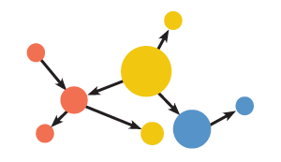
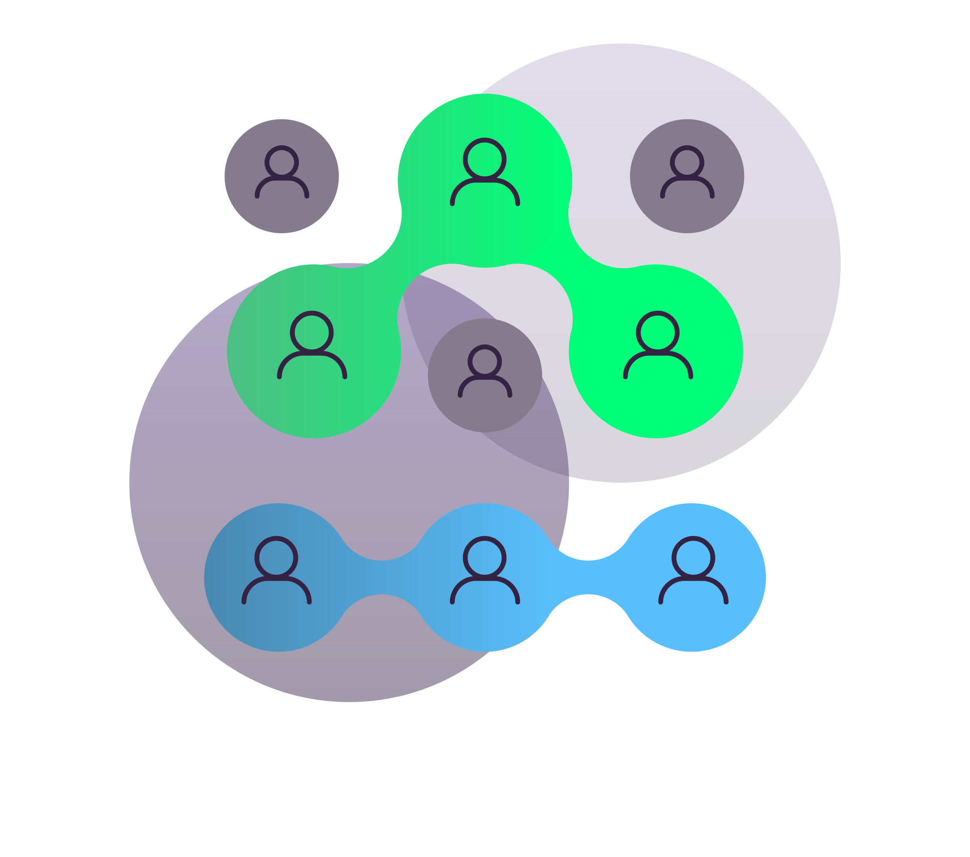
Related Work
Type of Rules | Applications of Rules
Association Analysis
Entity Resolution (ER)
Conflict Resolution (CR)
Rules have a wide range of applications, enhancing data quality in various areas
Association Analysis, Entity Resolution, Conflict Resolution
For the issue that data are incorrectly merged, how to solve it?
Currently, there is no solution designed for splitting tuples that are incorrectly merged.

Slide 9
Preliminaries: Entity Enhancing Rules (REEs)
Predicates over a database schema $ℛ=(R_{1},R_{2},…,R_{m})$
$p≔ R\left(t\right) \left| t.A⨁{c} \right| t.A⨁{s.B }$ | $M(t[\overline{A}], t[\overline{B}])$
Relation atom over schema R
Constant predicates
Non-constant predicates
ML predicates:
NLP models, e.g., NER
ER models, e.g., ditto
CR models, e.g., HoloDetect
An entity enhancing rule (REE) is a first-order logic formula, defined as
Precondition:
X is a conjunction of predicates
$$φ :X →p_{0}$$
consequence:
$p_{0}$ is a predicate over $ℛ$
Notes:
Before present our method, we first introduce the REE rules and its extended version in this paper.
REEs is a first-order logic formula in the form of X implies $p_{0}$.
Here X is the precondition of rule, it is a set of predicates. $p_{0}$ is the consequence of rule.
Predicates are the traditional constant and non-constant predicates, they are commonly used.

Slide 10
Preliminaries: Examples of REEs
$$φ_{1 }: Drug(s_{a})∧Disease(t_{a})∧Disease(t_{b})∧s_{a}.cid=t_{a}.cid∧ℳ_{therapy}(t_{a},t_{b}) →s_{a}.cid=t_{b}.cid.$$
Here $ℳ_{therapy}$ is an ML model for checking the common therapies of two diseases.
This rule helps us discover the use of a known drug $s_{a}$for the disease in $t_{b}$ since Disease has not recorded the fact “$s_{a}$ can be used for $t_{b}$” yet.

Slide 11
Preliminaries: Properties of REEs
Support
Measures how frequently a rule is applied
$$spset(φ, D)=\{\left\langle h\left(t\right), s(s)\right\rangle |h∈H,h⊨φ\}$$
$$supp(φ, D)=|spset\left(φ,D\right)|$$
Minimality
non-trivial, left-reduced
A minimal REE on data D is a non-trivial and left-reduced REE.
Confidence
Indicates how often an REE has been found to be true
$$conf(φ, D)=supp(φ, D)/supp(X,D)$$
Cover of rules
REEs implication
A set of rules is minimal if it includes no redundant rules, i.e., rules cannot be entailed by remaining ones

Slide 12
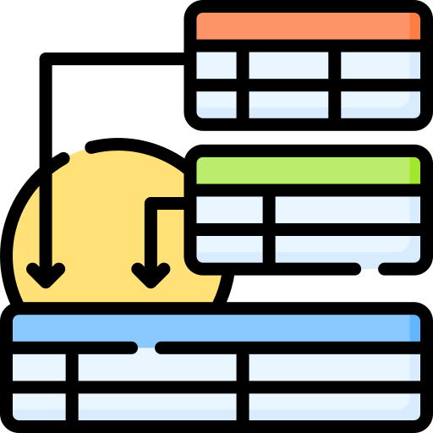
Main Idea: Splitting Tuples of Mismatched Entities
Issue：Tuples representing different entities are incorrectly merged
Solution： Split tuples of mismatched entities
Input： A schema 𝑅, a relation 𝐷 of 𝑅, and a knowledge graph 𝐺
Output： The split 𝑇𝑆(𝑡) for all tuples 𝑡 in 𝐷, by referencing 𝐺
Detect Conflicts
Split / Correct
How to decide which tuples need to be split/corrected?
For tuples to be split, how to re-assign attributes?
After splitting/correction, how to impute missing values?

Slide 13
A Scheme for Splitting Tuples
attribute value
conflict value
knowledge graph
HER
context
correct value
context
missing value
context
DecideTS
Splitting
Completing
D
D_{V}
D_{V}
D_{V}
User verification
③ Deducing missing values：For tuples returned by former step, deduce and fill in missing values
① Detects conflicts：For each tuple t in D, check whether it contains conflict. If so, query KG to decide split or correct tuple t.
For tuples to split, decompose it into multiple tuples initially
(optional)
② Split/Correct tuples：
For a tuple to split, it distributes
attribute values to right entities. For tuples with errors, it resolves the conflicts by enforcing REE⁺s and accumulating/referencing a set Γ of validated facts (ground truth).
Notes:
Bases on the extended REE+ rules, we propose a scheme for tuple splitting problem, named SET.
It includes three phases:
DecideTS: is to detect the conflicts in tuples and do the initial split for mismatched tuples;
Splitting: is to split tuples of mismatched entities and correct tuples with errors.
Completing: is to deduce and fill in missing values of split tuples.
All phases support three strategies: logic deduction, data extraction from knowledge graphs, and ML prediction.

Slide 14
Extend REEs to REE⁺s
Extended predicates over a database schema $ℛ=(R_{1},R_{2},…,R_{m})$
predicates for heterogeneous entity resolution (HER) across relations and knowledge graphs
if $match\left(t.A,x.ρ\right)$=true, $t\left[A\right]= val\left(x.ρ\right)$ indicates the $A$-attribute of $t$ takes the value (label) of the last vertex $v$ on the match of $ρ$ from vertex $x$.
$x$ in $vertex(x, G)$ is a variable denoting a vertex in knowledge graph $G$
whether a label path $ρ$ from vertex $x$ encodes the $A$-attribute of tuple $t$
$x∈vertex\left(x, G\right),t∈R(t),$ t and s represent the same entity
$p := vertex\left(x, G\right) \left| HER\left(t, x\right) \right| match\left(t.A,x.ρ\right) \left| t\left[A\right]= val\left(x.ρ\right) \right|$
$M_{c}(t[\overline{A}], t[B]) ≥ δ | M_{c}(t[\overline{A}], t[B]=c) ≥ δ | t[B] = M_{d}(t[\overline{A}], B)$
$M_{c}$ is an ML model that checks the strength of the correlation between (partial) tuple $t[\overline{A}]$and the $B$-attribute value $t[B]$, and $δ$ is a strength threshold
$M_{d}$ is an ML model that given a partial tuple $t[\overline{A}]$, predicts a value for its $B$-attribute.
ML predicates for determining correlated values
predicates for imputing missing values by data extraction from KG
Notes:
In this paper, we extended REE rules to REE+ rules, by supporting more predicates.
1. The first four predicates are to identify entities across relational data D to the knowledge graph G.
2. The two Mc predicates is used to assess correlation between values.
3. The last Md predicate is to suggest a value for missing values.

Slide 15
Network structure of $M_{c}$ and $M_{d}$ models in REE⁺s
knowledge graph $G$
tid | name | nationality | born | college | film | filmFestival | festCity | festCountry
t_{s} | Noemi Schneider | Swiss | 2013 | null | Sturm | DOK. fest | Munich | null
pretrain
Graph embedding
Pretrained language model
HER
Average pooling
Average pooling
Attention + max pooling
candidates
Encoder
FC
c
softmax
concatenate
Learn to rank
softmax
0/1
FC
Top-K values
$M_{d}$: impute missing values.
$M_{c}$: assess correlation and detect conflicts
$M_{c}$ : (1) Graph pretraining on $G$; (2) Context-aware embeddings. We model $I_{t}=(t[\overline{A}], t[B])$as a sequence.
$M_{d}$ : (1) Candidate values retrieval; (2) Ranking model to get the top-ranked values.
Notes:
Here we briefly introduce our Mc and Md model.
Mc is used to assess correlation between values. It mainly includes learning graph pretraining embeddings and context-aware embeddings.
Graph pretraining. We pretrain graph embeddings on a knowledge graph G, so that we can implicitly learn rich contextual information (e.g., DOK.fest held in Munich) from pretrained embedding.
Context-aware embedding. We model $It = (t[\overline{A}], t[B])$as a sequence by concatenating attribute values) and design encoders to obtain two representations of $It$ via graph embeddings and language models, respectively. After a softmax layer, we combine the classifications and generate a confidence score by incorporating semantics.
Md is to suggest a value for missing values. It first retrieve candidate values by HER, then train a ranking model to select the top-ranked value for the inputaiton.
Candidate values retrieval. We retrieve the set Cand of candidate values for 𝑡 [𝐵] via HER.
Ranking Model.
Next we train a ranking model to get the top-ranked value in Cand as the 𝐵 suggested value for 𝑡 [𝐵].

Slide 16
An Example Illustrating the Process of the Scheme
attribute value
knowledge graph
conflict value
HER
context
correct value
context
context
missing value
Attribute
Assignment
Missing Value
Imputation
DecideTS
D
D_{V}
D_{V}
D_{V}
User verification
(optional)
attribute value
conflict value
knowledge graph
correct value
HER
context
missing value
context
context
DecideTS
Splitting
Completing
D
D_{V}
D_{V}
D_{V}
User verification
(optional)

Slide 17
An Example Illustrating the Process of the Scheme
attribute value
knowledge graph
conflict value
HER
context
correct value
context
context
missing value
Attribute
Assignment
Missing Value
Imputation
DecideTS
D
D_{V}
D_{V}
D_{V}
User verification
(optional)
information from the Swiss director
information from the German director
erroneous values
tid | name | nationality | born | college | film | filmFestival | festCity | festCountry
t_{s} | Noemi Schneider | Swiss | 2013 | null | Sturm | DOK.fest | Munich | null
attribute value
conflict value
knowledge graph
correct value
HER
context
missing value
context
context
DecideTS
Splitting
Completing
D
D_{V}
D_{V}
D_{V}
User verification
(optional)

Slide 18
Step 1: Detect Tuples with Conflicts
attribute value
knowledge graph
conflict value
HER
context
correct value
context
context
missing value
Attribute
Assignment
Missing Value
Imputation
DecideTS
D
D_{V}
D_{V}
D_{V}
User verification
(optional)
information from the Swiss director
information from the German director
erroneous values
tid | name | nationality | born | college | film | filmFestival | festCity | festCountry
t_{s} | Noemi Schneider | Swiss | 2013 | null | Sturm | DOK.fest | Munich | null
attribute value
conflict value
knowledge graph
correct value
HER
context
missing value
context
context
DecideTS
Splitting
Completing
D
D_{V}
D_{V}
D_{V}
User verification
(optional)

Slide 19
Step 1: Detect Tuples with Conflicts
attribute value
knowledge graph
conflict value
HER
context
correct value
context
context
missing value
Attribute
Assignment
Missing Value
Imputation
DecideTS
D
D_{V}
D_{V}
D_{V}
User verification
(optional)
information from the Swiss director
information from the German director
erroneous values
tid | name | nationality | born | college | film | filmFestival | festCity | festCountry
t_{s} | Noemi Schneider | Swiss | 2013 | null | Sturm | DOK.fest | Munich | null
attribute value
conflict value
knowledge graph
correct value
HER
context
missing value
context
context
DecideTS
Splitting
Completing
D
D_{V}
D_{V}
D_{V}
User verification
(optional)
Notes:
no short film named “Sturm” was nominated at “DOK.fest”

Slide 20
t_{s} | Noemi Schneider | Swiss | 2013 | null | Sturm | DOK.fest | Munich | null
attribute value
knowledge graph
conflict value
HER
context
correct value
context
context
missing value
Attribute
Assignment
Missing Value
Imputation
DecideTS
D
D_{V}
D_{V}
D_{V}
User verification
(optional)
tid | name | nationality | born | college | film | filmFestival | festCity | festCountry
t_{a} | Noemi Schneider | null | null | null | Sturm | null | null | null
t_{b} | Noemi Schneider | null | null | null | null | DOK.fest | null | null
attribute value
conflict value
knowledge graph
correct value
HER
context
missing value
context
context
DecideTS
Splitting
Completing
D
D_{V}
D_{V}
D_{V}
User verification
(optional)

Slide 21
Step 2: Splitting/Correcting Tuples with Conflicts
attribute value
knowledge graph
conflict value
HER
context
correct value
context
context
missing value
Attribute
Assignment
Missing Value
Imputation
DecideTS
D
D_{V}
D_{V}
D_{V}
User verification
(optional)
tid | name | nationality | born | college | film | filmFestival | festCity | festCountry
t_{a} | Noemi Schneider | null | null | null | Sturm | null | null | null
t_{b} | Noemi Schneider | null | null | null | null | DOK.fest | null | null
attribute value
conflict value
knowledge graph
correct value
HER
context
missing value
context
context
DecideTS
Splitting
Completing
D
D_{V}
D_{V}
D_{V}
User verification
(optional)

Slide 22
t_{s} | Noemi Schneider | Swiss | 2013 | null | Sturm | DOK.fest | Munich | null
attribute value
knowledge graph
conflict value
HER
context
correct value
context
context
missing value
Attribute
Assignment
Missing Value
Imputation
DecideTS
D
D_{V}
D_{V}
D_{V}
User verification
(optional)
tid | name | nationality | born | college | film | filmFestival | festCity | festCountry
t_{a} | Noemi Schneider | null | null | null | Sturm | null | null | null
t_{b} | Noemi Schneider | null | null | null | null | DOK.fest | null | null
attribute value
conflict value
knowledge graph
correct value
HER
context
missing value
context
context
DecideTS
Splitting
Completing
D
D_{V}
D_{V}
D_{V}
User verification
(optional)

Slide 23
t_{s} | Noemi Schneider | Swiss | 2013 | null | Sturm | DOK.fest | Munich | null
attribute value
knowledge graph
conflict value
HER
context
correct value
context
context
missing value
Attribute
Assignment
Missing Value
Imputation
DecideTS
D
D_{V}
D_{V}
D_{V}
User verification
(optional)
tid | name | nationality | born | college | film | filmFestival | festCity | festCountry
t_{a} | Noemi Schneider | null | null | null | Sturm | null | null | null
t_{b} | Noemi Schneider | null | null | null | null | DOK.fest | null | null
attribute value
conflict value
knowledge graph
correct value
HER
context
missing value
context
context
DecideTS
Splitting
Completing
D
D_{V}
D_{V}
D_{V}
User verification
(optional)

Slide 24
t_{s} | Noemi Schneider | Swiss | 2013 | null | Sturm | DOK.fest | Munich | null
attribute value
knowledge graph
conflict value
HER
context
correct value
context
context
missing value
Attribute
Assignment
Missing Value
Imputation
DecideTS
D
D_{V}
D_{V}
D_{V}
User verification
(optional)
tid | name | nationality | born | college | film | filmFestival | festCity | festCountry
t_{a} | Noemi Schneider | null | null | null | Sturm | null | null | null
t_{b} | Noemi Schneider | null | null | null | null | DOK.fest | Munich | null
attribute value
conflict value
knowledge graph
correct value
HER
context
missing value
context
context
DecideTS
Splitting
Completing
D
D_{V}
D_{V}
D_{V}
User verification
(optional)

Slide 25
t_{s} | Noemi Schneider | Swiss | 2013 | null | Sturm | DOK.fest | Munich | null
attribute value
knowledge graph
conflict value
HER
context
correct value
context
context
missing value
Attribute
Assignment
Missing Value
Imputation
DecideTS
D
D_{V}
D_{V}
D_{V}
User verification
(optional)
tid | name | nationality | born | college | film | filmFestival | festCity | festCountry
t_{a} | Noemi Schneider | null | null | null | Sturm | null | null | null
t_{b} | Noemi Schneider | null | null | null | null | DOK.fest | Munich | null
attribute value
conflict value
knowledge graph
correct value
HER
context
missing value
context
context
DecideTS
Splitting
Completing
D
D_{V}
D_{V}
D_{V}
User verification
(optional)

Slide 26
t_{s} | Noemi Schneider | Swiss | 2013 | null | Sturm | DOK.fest | Munich | null
attribute value
knowledge graph
conflict value
HER
context
correct value
context
context
missing value
Attribute
Assignment
Missing Value
Imputation
DecideTS
D
D_{V}
D_{V}
D_{V}
User verification
(optional)
tid | name | nationality | born | college | film | filmFestival | festCity | festCountry
t_{a} | Noemi Schneider | Swiss | null | null | Sturm | null | null | null
t_{b} | Noemi Schneider | null | null | null | null | DOK.fest | Munich | null
attribute value
conflict value
knowledge graph
correct value
HER
context
missing value
context
context
DecideTS
Splitting
Completing
D
D_{V}
D_{V}
D_{V}
User verification
(optional)

Slide 27
t_{s} | Noemi Schneider | Swiss | 2013 | null | Sturm | DOK.fest | Munich | null
attribute value
knowledge graph
conflict value
HER
context
correct value
context
context
missing value
Attribute
Assignment
Missing Value
Imputation
DecideTS
D
D_{V}
D_{V}
D_{V}
User verification
(optional)
tid | name | nationality | born | college | film | filmFestival | festCity | festCountry
t_{a} | Noemi Schneider | Swiss | null | null | Sturm | null | null | null
t_{b} | Noemi Schneider | null | null | null | null | DOK.fest | Munich | null
attribute value
conflict value
knowledge graph
correct value
HER
context
missing value
context
context
DecideTS
Splitting
Completing
D
D_{V}
D_{V}
D_{V}
User verification
(optional)

Slide 28
Step 3: Deduce and Fill in Missing Values
attribute value
knowledge graph
conflict value
HER
context
correct value
context
context
missing value
Attribute
Assignment
Missing Value
Imputation
DecideTS
D
D_{V}
D_{V}
D_{V}
User verification
(optional)
tid | name | nationality | born | college | film | filmFestival | festCity | festCountry
t_{a} | Noemi Schneider | Swiss | null | null | Sturm | null | null | null
t_{b} | Noemi Schneider | null | null | null | null | DOK.fest | Munich | null
attribute value
conflict value
knowledge graph
correct value
HER
context
missing value
context
context
DecideTS
Splitting
Completing
D
D_{V}
D_{V}
D_{V}
User verification
(optional)

Slide 29
t_{s} | Noemi Schneider | Swiss | 2013 | null | Sturm | DOK.fest | Munich | null
attribute value
knowledge graph
conflict value
HER
context
correct value
context
context
missing value
Attribute
Assignment
Missing Value
Imputation
DecideTS
D
D_{V}
D_{V}
D_{V}
User verification
(optional)
tid | name | nationality | born | college | film | filmFestival | festCity | festCountry
t_{a} | Noemi Schneider | Swiss | null | null | Sturm | null | null | null
t_{b} | Noemi Schneider | null | null | null | null | DOK.fest | Munich | null
attribute value
conflict value
knowledge graph
correct value
HER
context
missing value
context
context
DecideTS
Splitting
Completing
D
D_{V}
D_{V}
D_{V}
User verification
(optional)

Slide 30
t_{s} | Noemi Schneider | Swiss | 2013 | null | Sturm | DOK.fest | Munich | null
attribute value
knowledge graph
conflict value
HER
context
correct value
context
context
missing value
Attribute
Assignment
Missing Value
Imputation
DecideTS
D
D_{V}
D_{V}
D_{V}
User verification
(optional)
$$φ:Person\left(t\right)∧t.festCity=Munich →t.festCountry=Germany$$
tid | name | nationality | born | college | film | filmFestival | festCity | festCountry
t_{a} | Noemi Schneider | Swiss | null | null | Sturm | null | null | null
t_{b} | Noemi Schneider | null | null | null | null | DOK.fest | Munich | null
attribute value
conflict value
knowledge graph
correct value
HER
context
missing value
context
context
DecideTS
Splitting
Completing
D
D_{V}
D_{V}
D_{V}
User verification
(optional)

Slide 31
t_{s} | Noemi Schneider | Swiss | 2013 | null | Sturm | DOK.fest | Munich | null
attribute value
knowledge graph
conflict value
HER
context
correct value
context
context
missing value
Attribute
Assignment
Missing Value
Imputation
DecideTS
D
D_{V}
D_{V}
D_{V}
User verification
(optional)
$$φ:Person\left(t\right)∧t.festCity=Munich →t.festCountry=Germany$$
tid | name | nationality | born | college | film | filmFestival | festCity | festCountry
t_{a} | Noemi Schneider | Swiss | null | null | Sturm | null | null | null
t_{b} | Noemi Schneider | null | null | null | null | DOK.fest | Munich | Germany
attribute value
conflict value
knowledge graph
correct value
HER
context
missing value
context
context
DecideTS
Splitting
Completing
D
D_{V}
D_{V}
D_{V}
User verification
(optional)

Slide 32
t_{s} | Noemi Schneider | Swiss | 2013 | null | Sturm | DOK.fest | Munich | null
attribute value
knowledge graph
conflict value
HER
context
correct value
context
context
missing value
Attribute
Assignment
Missing Value
Imputation
DecideTS
D
D_{V}
D_{V}
D_{V}
User verification
(optional)
tid | name | nationality | born | college | film | filmFestival | festCity | festCountry
t_{a} | Noemi Schneider | Swiss | 1986 | ZHdK | Sturm | Landshut Short Film Festival | Landshut | Germany
t_{b} | Noemi Schneider | German | 1982 | HFF Munich | Walaa! | DOK.fest | Munich | Germany
attribute value
conflict value
knowledge graph
correct value
HER
context
missing value
context
context
DecideTS
Splitting
Completing
D
D_{V}
D_{V}
D_{V}
User verification
(optional)

Slide 33
Experimental Settings
Datasets
Name | $$|D_{0}|$$ | $$|D|$$ | # of real mismatches | # of tuples to correct
Citation | 51,485 | 22,826 | 207 | 1,028
College | 20,483 | 4,670 | 124 | 206
Person | 948,856 | 285,962 | 4,936 | 13,721
IMDB | 3,205,737 | 1,057,217 | 4,670 | 49,521
Without Mc/Md
Without HER
Only Splitting
Only Correction
Brute-force for chase
Baselines
Variants：${SET}_{noML}$、${SET}_{noHER}$、${SET}_{split}$、${SET}_{correct}$ 、${SET}_{NC}$
Baselines：$Bert$、$Raran$、Holoclean、Imp3C
Metrics
Running Time, $F_{1}$-score
conducted data repairing based on CFD deduction on the ground truth
DS/MI is conducted as a ternary classifier/remedy model, AA is based on the confidences of DS
Raha + Baran
A hybrid data repairing method that integrates DCs, external information and statistics
Notes:
We tested our method in four real life data and compared with four baselines and some variants.
We compared our method with some baseline, such as ML-based Bert and Raran. Raran is the combination of Raha and Baran,
We also compared with rule-based Holoclean and Imp3C.
To test the preformance of some components of our method, we compared some variants.
$Bert$: Treats DS and MI as Downstream tasks of pretrained Bert

Slide 34
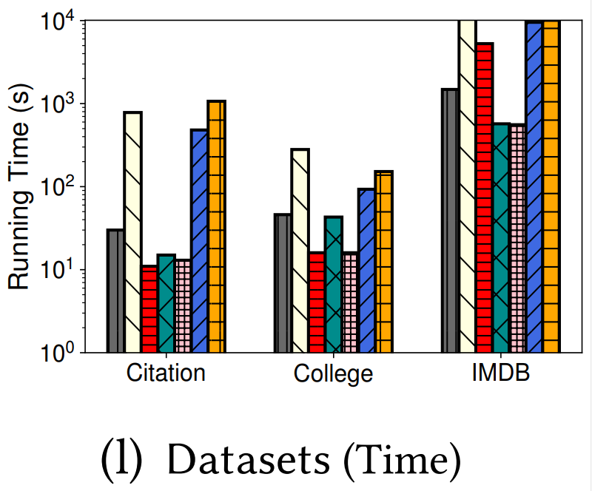
Exp-1: Running Time
Compared to rule-based methods like Imp3C, our approach is generally comparable in speed or slightly slower.
In contrast, it is significantly faster than ML based methods, e.g., on college dataset, SET takes 46s, speed up 2X and 3.3X over Bert and Raran, respectively.
$SET$ vs. ${SET}_{NC}$, speed up 11.5X.

Slide 35
Exp-2: $F_{1}$-score Performance
$SET$ vs. ${SET}_{split}$ vs. ${SET}_{correct}$, $F_{1}$-score improves by 43.5%、19.8%
$SET$ vs. rule-based baselines vs. ML-based baselines, $F_{1}$-score is 0.92、0.389、0.607
$SET$ vs. ${SET}_{noML}$ vs. ${SET}_{noHER}$, $F_{1}$-score improves by 17%、33.9%

Slide 36
Case study
We crawled a person dataset with schema 𝑅 = (name, DoB, death, occupation, party) from Wikipedia.
We obtained person tuples based on names (e.g., Hirai Taro ̄ [7]) and cited Wiki pages.
From the tuples, SET found a real mismatch, represented by 𝑡 = (“Hirai Taro ̄”, “21/10/1894”, “28/07/1965”, “Novelist”, “Liberal democratic party”). Here 𝑡 is a mismatch from a famous Japanese novelist and a Japanese councilor.
To correct it, SET splits 𝑡 as follows.
DS. By applying REE+ $φ:R(t)∧M_{c}(t[occupation],t[party])≤0.2→false$, SET finds the correlation between $t[occupation]$ and $t[party]$ is low (e.g., 0.1). Thus, $t$ is tuple to be split/correct. We reference Wikidata 𝐺 by HER and confirm that 𝑡 is a mismatched tuple of distinct entities (i.e., 𝑓 (𝑡) ∉ E). We then (initially) split TS(𝑡) into $\{t_{a},t_{b}\},$where $t_{a}$= (“HiraiTaro ̄”, null, null, “Novelist”, null) and $t_{b}$ = (“HiraiTaro ̄”, null, null, null, “Liberal democratic party”).
AA. To distribute “21/10/1894” of $t\left[DoB\right],$we apply $φ_{2}: R(t) ∧ Mc (t[name, occupation], t[DoB]=“21/10/1894”)≥0.6→t[DoB]=“21/10/1894”$ via valuation h: 𝑡𝑎 → 𝑡 of 𝜑. $Since M_{c}(t_{a}[name, occupation], “21/10/1894”)=0.8>0.6$, “21/10/1894” is strongly correlated with $t_{a}$; thus we assign it to $t_{a}\left[DoB\right]$by $φ_{2}$. Similarly, we assign “28/07/1965” of $t[death]$to $t_{a}[death]$.
Notes:
We present the case study to show how we split tuples using our scheme.
But due to the time limitation, I will not give the details, anyone interested can refer to our paper.

Slide 37
Case study
We crawled a person dataset with schema 𝑅 = (name, DoB, death, occupation, party) from Wikipedia.
We obtained person tuples based on names (e.g., Hirai Taro ̄ [7]) and cited Wiki pages.
From the tuples, SET found a real mismatch, represented by 𝑡 = (“Hirai Taro ̄”, “21/10/1894”, “28/07/1965”, “Novelist”, “Liberal democratic party”). Here 𝑡 is a mismatch from a famous Japanese novelist and a Japanese councilor.
To correct it, SET splits 𝑡 as follows.
MI. To impute null values in TS(𝑡), e.g., $t_{b}[occupation]$, SET uses Wikidata as external knowledge graph 𝐺 and applies $φ_{3}: R\left(t\right)∧vertex\left(x,Wikidata\right)∧HER\left(t,x\right)∧ match\left(t\left[occupation\right], x.\left(occupation\right)\right)→t\left[occupation\right]=val(x.occupation)$, setting $t_{b}\left[occupation\right]= “Councilor”.$ After filling in all requested null values, the splitting of 𝑡 is done, with $t_{a}$ = (“Hirai Taro ̄”, “21/10/1894”, “28/07/1965”, “Novelist”, “Nonparty”) and $t_{b}$ = (“Hirai Taro ̄”, “17/07/1905”, “04/12/1973”, “Councilor”, “Liberal democratic party”).

Slide 38
Conclusion
We have studied tuple splitting problem
A new problem for tuple splitting
A scheme SET (Splitting EnTities), an extension of error correction with tuple splitting
by unifying logic rules, ML models and data extraction in the same process
DecideTS (DS): Detecting mismatched/corrected tuples
Attribute assignment (AA): Split/correct tuples with conflicts
Missing values imputation (MI): Deduce and fill in missing values
Extending REEs to REE⁺s. By employing REE+s, SET splits mismatched tuples and corrects errors in a uniform process of logic deduction, ML correlation and data extraction
Our experimental study has shown that the methods are promising
Notes:
In conclusion, we have studied the tuple splitting problem.
We propose a scheme, it solves error correction and tuple splitting, by using logic rules, ML models, and data extraction in the same process.
Our experimental study shows that our method is very promising in practice.

