Slide 1
Discovering Top-k Rules using Subjective and Objective Criteria
Wenfei Fan Ziyan Han Yaoshu Wang Min Xie*

Slide 2
Background: Rules are Vital in Data Management
Data Quality Rules: Functional Dependencies (FDs), Conditional Functional Dependencies (CFDs), Denial Constraints (DCs), Matching Dependencies (MDs), Entity Enhancing Rules (REEs), etc.
Rule Discovery:
Domain Experts $−$ write/discover rules manual $−$ high cost
Automatic rule discovery $−$ faces challenges such as large data, complex rules, etc.
Rule Applications:
Conflict Resolution (CR): Detect/correct inconsistencies and missing values.
Entity Resolution (ER): Eliminate redundancy and consolidate identical entities.
Tuple Splitting (TS): Fix incorrectly merged tuples and redistribute attributes.
Notes:
Rules play a critical role in many aspects of data management

Slide 3
Challenge: hard to mine rules that fit users’ needs
Excessive rules — high interaction cost for users to select as needed
Rule discovery based on objective evaluation criteria — difficulty in mine rules that fit users’ needs
Select interesting rules
Large number of rules

Slide 4
Challenge: hard to mine rules that fit users’ needs
Excessive Rules: Practitioners are overwhelmed
Rule discovery often yields excessive rules, users need to spend a huge amount of time to manually inspect and select rules that fit their needs.
For example, on a dataset with 27 attributes and 368 tuples, 128,726 functional dependencies (FDs) are found^{[1]}.
How to design effective top-k discovery methods?
Rule Evaluation Metrics are NOT Comprehensive, Lacking Subjective Criteria
Existing rule discovery algorithms typically consider only objective criteria such as support and confidence, lacking subjective criteria and neglecting users’ preferences.
This yields rules that may be already known or common sense, failing to meet user preferences and practical application needs.
1. How to obtain user preferences and design subjective metrics?
2. How to design top-k discovery methods, incorporating subjective metrics?
Notes:
Rules play a critical role in many aspects of data management

Slide 5
Related Work
Type of Rules | Rule Discovery | Assessment of Rules
Rules | Forms | Expressive Capability | Application Scenarios
FDs | $$X→Y$$ | FDs | Schema design
CFDs | $$X→A,t_{p}$$ | FDs, CFDs | Conflict resolution
MDs | $$\bigwedge_{j∈\left[1,k\right]}{\left(R_{1}\left[A_{j}\right]≈_{j}R_{2}\left[B_{j}\right]\right)→} \\ \bigwedge_{i∈[1,h]}{(R_{1}[E_{i}]⇋R_{2}[F_{j}])}$$ | MDs | Entity resolution
DCs | $$∀t_{x},t_{y}∈r,¬(p_{1},…,p_{m})$$ | DCs | Conflict resolution
REEs | $$p≔R\left(t\right)\left|t.A⊗c\right|$$ $$t.A⊗s.B|M(t\left[\overline{A}\right], s\left[\overline{B}\right])$$ $X→Y$, $⊗∈\{=, ≠,<,≤,>,≥\}$ | FDs, CFDs, MDs, DCs | Entity resolution Conflict resolution Tuple splitting
REEs subsume CFDs, DCs and MDs as special cases,
having strong expressive capabilities and wide-ranging application scenarios;
However, there is still a lack of algorithms for discovering top-k REEs.
Notes:
Rules play a critical role in many aspects of data management

Slide 6
Related Work
Type of Rules | Rule Discovery | Assessment of Rules
Types | Algorithms | Rules | Main ideas
Levelwise | TANE, FUN, FD_mine, Depmine, etc. | FDs | Based on levelwise search, accelerated by indexing structures or other strategies
Levelwise | CTANE, tableau, etc. | CFDs
DFS | DFD, FastFDs, etc. | FDs | Based on DFS search, enhanced with auxiliary structures such as different sets or evidence sets
DFS | FastDC, Hydra, DCFinder, etc. | bi-variable DCs
Hybrid | HyMD, Mdedup, etc. | MDs | Based on levelwise and DFS
Learning-based | AutoFD, etc. | FDs | Utilize inductive learning, structural learning, etc.
Top-k | K-optimal rule discovery | Association rules | Discover k-Optimal Association Rules
Existing rule discovery methods encounter several issues:
(1) Tuple variables limited to 2; (2) Lack of constant patterns ; (3) Lack of ML predicates; (4) Defined on single table; etc.
Notes:
Rules play a critical role in many aspects of data management

Slide 7
Related Work
Type of Rules | Rule Discovery | Assessment of Rules
Methods | Main ideas | Issues
Mdedup^{[1]} | Employs objective features for MDs and adopts the ML regression model and Gaussian Process to learn an MD score | It aims to discover MDs with high F-measures, not for users’ application needs
NLM^{[2]} LINN^{[3]} | Designed ML models to learn the representations of rules | Not consider how to learn subjective criteria for rules
Assessment of rules during discovery: objective and subjective measures
No existing algorithms incorporate user interests or design subjective metrics.
[1] loannis Koumarelas, Thorsten Papenbrock, and Felix Naumann. MDedup: Duplicate detection with matching dependencies. PVLDB (2020).
[2] Honghua Dong, Jiayuan Mao, Tian Lin, Chong Wang, Lihong Li, and Denny Zhou. Neural Logic Machines. ICLR (2019).
[3] Shaoyun Shi, Hanxiong Chen, Weizhi Ma, Jiaxin Mao, Min Zhang, and Yongfeng Zhang. Neural Logic Reasoning. CIKM (2020).
Notes:
Rules play a critical role in many aspects of data management

Slide 8
Preliminaries: Entity Enhancing Rules (REEs)
Predicates over a database schema $ℛ=(R_{1},R_{2},…,R_{m})$
$p≔ R\left(t\right) \left| t.A⨁{c} \right| t.A⨁{s.B }$ | $M(t[\overline{A}], t[\overline{B}])$
Relation atom over schema R
Constant predicates
Non-constant predicates
ML predicates:
NLP models, e.g., NER
ER models, e.g., ditto
CR models, e.g., HoloDetect
An entity enhancing rule (REE) is a first-order logic formula, defined as
Precondition:
X is a conjunction of predicates
$$φ :X →p_{0}$$
consequence:
$p_{0}$ is a predicate over $ℛ$
Notes:
Before present our method, we first introduce the REE rules and its extended version in this paper.
REEs is a first-order logic formula in the form of X implies $p_{0}$.
Here X is the precondition of rule, it is a set of predicates. $p_{0}$ is the consequence of rule.
Predicates are the traditional constant and non-constant predicates, they are commonly used.

Slide 9
Preliminaries: Examples of REEs
$$φ_{1 }: Drug(s_{a})∧Disease(t_{a})∧Disease(t_{b})∧s_{a}.cid=t_{a}.cid∧ℳ_{therapy}(t_{a},t_{b}) →s_{a}.cid=t_{b}.cid.$$
Here $ℳ_{therapy}$ is an ML model for checking the common therapies of two diseases.
This rule helps us discover the use of a known drug $s_{a}$for the disease in $t_{b}$ since Disease has not recorded the fact “$s_{a}$ can be used for $t_{b}$” yet.

Slide 10
Preliminaries: Properties of REEs
Support
Measures how frequently a rule is applied
$$spset(φ, D)=\{\left\langle h\left(t\right), s(s)\right\rangle |h∈H,h⊨φ\}$$
$$supp(φ, D)=|spset\left(φ,D\right)|$$
Minimality
non-trivial, left-reduced
A minimal REE on data D is a non-trivial and left-reduced REE.
Confidence
Indicates how often an REE has been found to be true
$$conf(φ, D)=supp(φ, D)/supp(X,D)$$
Cover of rules
REEs implication
A set of rules is minimal if it includes no redundant rules, i.e., rules cannot be entailed by remaining ones

Slide 11
Main Idea: Discovering Top-k Rules using Bi-criteria
Issue: Large number of rules, making it difficult to select as needed
Solution: Incorporate subjective criteria into Top-k rule discovery
$${ Σ}_{all}$$
All rules${ Σ}_{all}$
How to obtain next Top-k rules？
Relational Data $𝒟$
rule 1
rule k+1
rule 2
rule k+2
rule 3
rule k+3
How to obtain users preference?
…
…
rule k
rule 2k
How to accelerate?

Slide 12
Framework
Rule Pool $S_{REEs}$
Top-k REEs
Active learning
Pruning Strategies
Topk-Miner
Bi-criteria $M_{bi}$
Minimal REEs
Correlated predicate
① Objective criteria
Auxiliary Structure
$$w_{prefer}$$
Anti-monotonicity
Early termination
$$REE φ_{i}$$
$$REE φ_{j}$$
Token Embedding
Token Embedding
Anytime-Miner
Exact Bound
Predicate Embedding
Predicate Embedding
Partial rules
Rule Embedding
Rule Embedding
Lazy evaluation
Learned Bound UBSCORE
Lightweight model
RL
② Subjective criteria
Relative ranking of $φ_{i}$ and $φ_{j}$
$$M_{sub}$$
Next top-k REEs

Slide 13
Technique 1: Bi-criteria Relevance Model $M_{bi}$
Evaluation Metrics
Objective Criteria: support, confidence, succinctness, etc.
Subjective criteria: obtain user preferences applicable to different scenarios and user needs.
Ranking Score
$$score(φ)=\sum_{f∈F}{w_{f}f\left(φ\right)+}\sum_{g∈G}{w_{g}g(φ)}$$
$w_{f}$ and $w_{g}$ are non-negative weights associated with the measures
$f$: objective criteria
$g$: subjective criteria
$w_{prefer}$: complete weight vector

Slide 14
Technique 1: Bi-criteria Relevance Model $M_{bi}$
Subjective Model $M_{sub}$
Bi-criteria $M_{bi}$
Input: rule $φ$
Output：subjective score $M_{sub}\left(φ\right)$
Lightweight model
① Objective criteria
$$w_{prefer}$$
$$REE φ_{i}$$
$$REE φ_{j}$$
Token Embedding
Token Embedding
Rule embedding
Predicate Embedding
Predicate Embedding
Rule Embedding
Rule Embedding
$$M_{sub}\left(φ\right)={UB}_{sub}−ReLU (w_{light}^{T}E_{φ}+b_{light})$$
Lightweight model
② Subjective criteria
subjective score (lose) upper bound：
$${M_{sub}\left(φ\right)≤UB}_{sub}$$
Learnable parameters
Relative ranking of $φ_{i}$ and $φ_{j}$
$$M_{sub}$$

Slide 15
Technique 1: Bi-criteria Relevance Model $M_{bi}$
Active Learning / Pairwise Ranking
Maintain a rule pool
Given a rule pair $\left\langle φ_{i},φ_{j}\right\rangle$, label 1/0, if user think $φ_{i}$ is ranked higher than $φ_{j}$
Rule Pool $S_{REEs}$
Iteratively learn $M_{bi}$actively select rule pairs in $S_{REEs}$ that $M_{bi}$ cannot distinguish well, i.e., pairs that have the smallest differences in ranking scores, and ask users for labeling.
Active learning
Bi-criteria $M_{bi}$
$$Pr\left(φ_{i}≪φ_{j}\right)=Sigmoid(score\left(φ_{i}\right)−score(φ_{j}))$$
$$ℒ_{CE}=\sum_{i,j}{y^{\left(i,j\right)}log}\left(Pr\left(φ_{i}≪φ_{j}\right)\right)+(1−y^{\left(i,j\right)})Pr\left(φ_{i}≪φ_{j}\right)$$

Slide 16
Technique 2: Top-k Rule Discovery
Level-wise search algorithm
Issue 1: How to accelerate discovery process by pruning rules that cannot become Top-k results for early termination?
$$(∅, P_{all}, p_{0})$$
Issue 2: Similar to how users browse web pages, how to constantly discover the next top-k rules in real time?
$$(P_{1},\left\{P_{all}\backslash P_{1}\right\},p_{0})$$
$$(P_{2},\left\{P_{all}\backslash P_{2}\right\},p_{0})$$
$$…$$
$$(P_{n},\left\{P_{all}\backslash P_{n}\right\},p_{0})$$
$$(P_{1}P_{2},\left\{P_{all}\backslash P_{1}P_{2}\right\},p_{0})$$
$$…$$
$$(P_{2}P_{n},\left\{P_{all}\backslash P_{2}P_{n}\right\},p_{0})$$
$$(P_{1}P_{2}P_{n},\left\{P_{all}\backslash P_{1}P_{2}P_{n}\right\},p_{0})$$
…
$$(P_{n−2}P_{n−1}P_{n},\left\{P_{all}\backslash P_{n−2}P_{n−1}P_{n}\right\},p_{0})$$
…
…
…
Triplets: $\left\{\left(P_{sel}, { P}_{re},{ p}_{0}\right)\right\}$ $=⇒$ candidate rules: $P_{sel}→$ $p_{0}$
$P_{sel}$: the set of predicates selected to constitute X;
$P_{re}$: the set of remaining predicates in $P_{all}$;

Slide 17
Technique 2: Top-k Rule Discovery
Optimization/Pruning Strategies
Priority queue $Σ$
(k=3)
Rules($φx$) | score($φx$)
$$φa$$ | 15
$$φb$$ | 12
$$φc$$ | 10
$$φ$$
$$X$$
$${ p}_{0}$$
$$φ′$$
$$X$$
$${ p}_{new}$$
$${ p}_{0}$$
$$T_{k}=10$$
Check whether $φ$ is a top-k rule, and update $Σ$ and $T_{k}$
Check pruning conditions to decide whether expand $φ$ further
[P1] Prune non-minimal REEs —— minimal rule is valid, no need to expand further
[P2] Prune REEs with low support —— anti-monotonicity
[P3] Prune low-ranked REEs —— if upper bound is lower than $T_{k}$, not promising
If $UB\left(φ\right)<T_{k}$, prune
How to compute $UB$?

Slide 18
Technique 2: Top-k Rule Discovery
Optimization/Pruning Strategies
Upper Bound of Rule Scores
UB = min{exact bound, UBSCORE bound}
If $UB\left(φ\right)<T_{k}$, no rules expanded from 𝜑 can make a top-𝑘 rule and thus, stop the expansion
Exact bound： monotonicity, anti-monotonicity, general
Learned bound $UBSCORE$：Using DQN model to learn the UB of the subjective score of rules
UB of confidence: $1.0$
UB of support: $supp(φ)$
UB of $M_{sub}$: ${UB}_{sub}$

Slide 19
Technique 2: Top-k Rule Discovery
Learned Subjective Upper Bound UBSCORE
action: next predicate p
reward: difference in subjective scores
AGENT
ENVIRONMENT
state: currently selected $𝒫_{sel}$
reward：$M_{sub}\left(𝒫_{sel}∪\left\{p\right\}→p_{0}\right)−M_{sub}(𝒫_{sel}→p_{0})$

Slide 20
Technique 2: Top-k Rule Discovery
Learned Upper Bound UBSCORE for $M_{sub}$
Randomly select a set of instances ${(𝒫}_{sel}→p_{0})$
Relational Data $𝒟$
Sampled Data $D_{s}$
AGENT
ENVIRONMENT
18
16
14
Predict upper bound UBSCORE for $M_{sub}$
12
10
Training instances:
$${(𝒫}_{sel}^{′}→p_{0},{UB}_{sub})$$
DQN Network
8
6
3
4
5
6
Regression Model

Slide 21
Technique 3: Anytime Top-k Rule Discovery
How to quick discover the Next Top-k rules
Basic Ideas
Lazy Evaluation
Instead of just the top-𝑘 rules, all minimal rules discovered are kept in $Σ$, referred to as complete rules
For rules with score lower than $T_{k},$we maintain them as partial rules (NOT prune directly as before)
For each partial rule whose score upper bound is among the next top-𝑘, we resume its levelwise search in order
Each time output next top-k rules, only return the next top-𝑘 complete rules in $Σ$
Top-𝑘 Queue

Slide 22
A pictorial example of top-k discovery method
Priority queue $Σ$
(k=3)
Rules($φx$) | score($φx$)
$$φa$$ | 15
$$φb$$ | 12
$$φc$$ | 10
$$φ$$
$$𝒫_{sel}:Drug\left(s_{a}\right),Disease\left(t_{a}\right),$$
$$Disease(t_{b})$$
$$p_{0}:s_{a}.cid=t_{b}.cid$$
UB computation for$φ$
UB = min{exact bound, UBSCORE bound}
$$T_{k}=10$$
T_{k} < UB？
$$UB\left(φ\right)=14$$
Yes, expand $φ$ with predicates in $𝒫_{re}$ in the support-based order
$𝒫_{re}$ (sorted by support )
$$p_{i}:s_{a}.cid=t_{a}.cid$$
$$p_{j}:Mtherapy(t_{a}, t_{b})$$
Add
$${ p}_{i}$$
Add
${ p}_{j}$
$$X$$
$${ p}_{0}$$
$$X$$
$${ p}_{i}$$
$${ p}_{0}$$
$$X$$
$${ p}_{i}$$
$${ p}_{j}$$
$${ p}_{0}$$
high
support
low
Expand
Priority queue $Σ$
(k=3)
Rules($φx$) | score($φx$)
$$φa$$ | 15
$$φ^{′}$$ | 13
$$φ_{b}$$ | 12
$$φ′$$
$$𝒫_{sel}:Drug\left(s_{a}\right),Disease\left(t_{a}\right),Disease\left(t_{b}\right),$$
$$s_{a}.cid=t_{a}.cid,M_{therapy}(t_{a},t_{b})$$
$${ p}_{0}$$
更新 $Σ$
$$score\left(φ′\right)=13$$
Compute exact score($φ$)
$$T_{k}=12$$

Slide 23
Experimental Settings
Datasets
Name | Type | #tuple | #attributes | #relations
Adult | real-life | 32,561 | 15 | 1
Airport | Real-life | 55,113 | 18 | 1
Hospital | Real-life | 114,919 | 15 | 1
DrugDisease | real-life | 466,658 | 35 | 4
Inspection | Real-life | 220,940 | 17 | 1
NCVoter | Real-life | 1,681,617 | 12 | 1
DBLP | Real-life | 1,799,559 | 18 | 3
Tax | synthetic | 10,000,000 | 15 | 1
mines all rules, filtering by objective scores and ranking by subjective scores
No pruning
No learned bound UBSCORE
Baselines
Variants： $Ptopk$-${Miner}_{nop}$、$Ptopk$-${Miner}_{noL}$、$Topk$-$Filter$
Baselines：$DCFinder$、$PMinerS\text{、}\text{AdaptiveMiner}$
Evaluation
Running Time, Accuracy of $M_{bi}$, Recall w.r.t rules from $Ptopk$-${Miner}_{nop}$
SOTA mine DCs
Discovery by sampling
Discover association rules

Slide 24
Exp-1: Running Time
$Ptopk$-$Miner$ vs. $Ptopk$-${Miner}_{nop}$, $Ptopk$-${Miner}_{noL}$, $PMinerS$, $DCFinder$, speed up 134X、6X、14X、86X
Anytime-Miner vs. Ptopk-Miner, speed up 52.8X, when users want the 4th top-10 rules

Slide 25
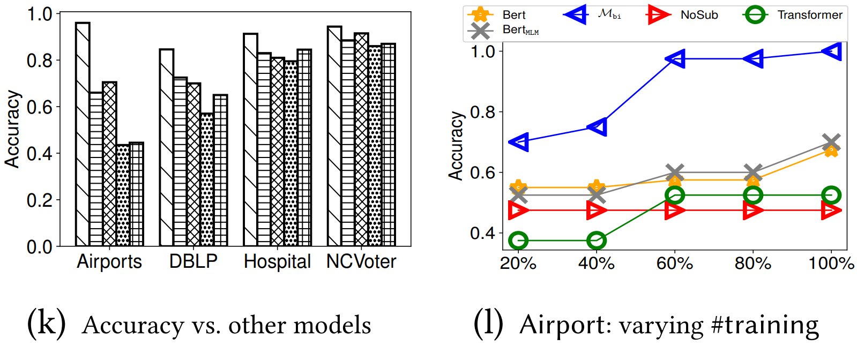
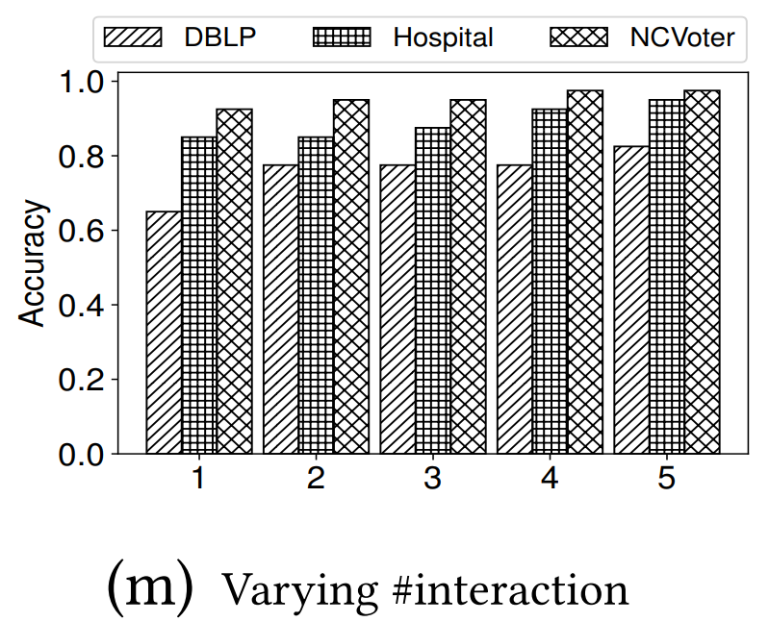
Exp-2: Accuracy/Recall
Bi-criteria model $M_{bi}$ vs. language models, accuracy improves 14.1%
NoSub vs. $M_{bi}$, accuracy 0.69 vs. 0.92
$Ptopk$-$Miner$ vs. $PMinerS$, recall is significantly improved
$Ptopk$-$Miner$ vs. decision tree (DT) vs. RIPPER𝑘 vs. FSDTO, evaluated on DrugDisease and Adult for multi-class/binary classification tasks, accuracy improves 3.3%、3.52%、3.82%, up to 4.1%、4.90%、5.5%

Slide 26
Conclusion
We have studied discovery of top-k rules. Our novelty consists of:
A bi-criteria model with both objective and subjective measures
An active-learning method to learn the subjective model and weight vector of various measures
A top-k algorithm for discovering REEs, which subsume common data quality rules and association rules as special cases
An anytime algorithm to continuously mine the next top-k rules via lazy evaluation
Parallelization of the algorithms with the parallel scalability
Our experimental study has shown that the methods are promising

