Slide 1
Parallel Rule Discovery from Large Datasets by Sampling
Wenfei Fan Ziyan Han Yaoshu Wang Min Xie

Slide 2
Background: Rules are Vital in Data Management
Data Quality Rules: Functional Dependencies (FDs), Conditional Functional Dependencies (CFDs), Denial Constraints (DCs), Matching Dependencies (MDs), Entity Enhancing Rules (REEs), etc.
Rule Discovery:
Domain Experts $−$ write/discover rules manual $−$ high cost
Automatic rule discovery $−$ faces challenges such as large data, complex rules, etc.
Rule Applications:
Conflict Resolution (CR): Detect/correct inconsistencies and missing values.
Entity Resolution (ER): Eliminate redundancy and consolidate identical entities.
Tuple Splitting (TS): Fix incorrectly merged tuples and redistribute attributes.
Notes:
Rules play a critical role in many aspects of data management

Slide 3
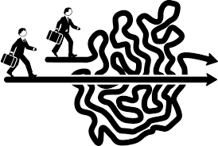
Challenge: High Computational Costs in Discovery
The high cost of rule discovery is a challenging issue, due to large data volumes, numerous attributes in relational schemas, complex rule forms, and so on, making it difficult to avoid in practical scenarios.
Notes:
Rules play a critical role in many aspects of data management

Slide 4
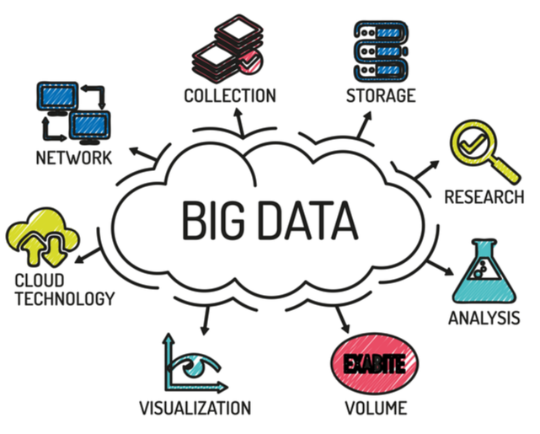
Challenge: High Computational Costs in Discovery
Large Data Volume / Numerous Attributes
In practice, massive data and large #attributes make discovery costly.
For example, discovering functional dependencies (FDs) in a dataset with 100 attributes and 300K tuples can take days or even longer.
How to design effective strategies to accelerate rule discovery?
Complex Rule Forms
Constant patterns, ML predicates, multiple table, multiple tuple variables
Greater rule expressiveness leads to increased complexity and higher discovery costs
High Complexity of Rule Discovery Algorithms
Large search space, exponential complexity
How to design effective pruning strategies to accelerate discovery algorithms?
How to design effective pruning strategies to accelerate discovery process?

Slide 5
Related Work
Type of Rules | Rule Discovery
Rules | Forms | Expressive Capability | Application Scenarios
FDs | $$X→Y$$ | FDs | Schema design
CFDs | $$X→A,t_{p}$$ | FDs, CFDs | Conflict resolution
MDs | $$\bigwedge_{j∈\left[1,k\right]}{\left(R_{1}\left[A_{j}\right]≈_{j}R_{2}\left[B_{j}\right]\right)→} \\ \bigwedge_{i∈[1,h]}{(R_{1}[E_{i}]⇋R_{2}[F_{j}])}$$ | MDs | Entity resolution
DCs | $$∀t_{x},t_{y}∈r,¬(p_{1},…,p_{m})$$ | DCs | Conflict resolution
REEs | $$p≔R\left(t\right)\left|t.A⊗c\right|$$ $$t.A⊗s.B|M(t\left[\overline{A}\right], s\left[\overline{B}\right])$$ $X→Y$, $⊗∈\{=, ≠,<,≤,>,≥\}$ | FDs, CFDs, MDs, DCs | Entity resolution Conflict resolution Tuple splitting
REEs subsume CFDs, DCs and MDs as special cases,
having strong expressive capabilities and wide-ranging application scenarios;
However, there is still a lack of algorithms for discovering REEs.
Notes:
Rules play a critical role in many aspects of data management

Slide 6
Related Work
Type of Rules | Rule Discovery
Types | Algorithms | Rules | Main ideas
Levelwise | TANE, FUN, FD_mine, Depmine, etc. | FDs | Based on levelwise search, accelerated by indexing structures or other strategies
Levelwise | CTANE, tableau, etc. | CFDs
DFS | DFD, FastFDs, etc. | FDs | Based on DFS search, enhanced with auxiliary structures such as different sets or evidence sets
DFS | FastDC, Hydra, DCFinder, etc. | bi-variable DCs
Hybrid | HyMD, Mdedup, etc. | MDs | Based on levelwise and DFS
Learning-based | AutoFD, etc. | FDs | Utilize inductive learning, structural learning, etc.
Top-k | K-optimal rule discovery | Association rules | Discover k-Optimal Association Rules
Existing rule discovery methods encounter several issues:
(1) Tuple variables limited to 2; (2) Lack of constant patterns ; (3) Lack of ML predicates; (4) Defined on single table; (5) Lack of accuracy boundaries; etc.
Notes:
Rules play a critical role in many aspects of data management

Slide 7
Preliminaries: Entity Enhancing Rules (REEs)
Predicates over a database schema $ℛ=(R_{1},R_{2},…,R_{m})$
$p≔ R\left(t\right) \left| t.A⨁{c} \right| t.A⨁{s.B }$ | $M(t[\overline{A}], t[\overline{B}])$
Relation atom over schema R
Constant predicates
Non-constant predicates
ML predicates:
NLP models, e.g., NER
ER models, e.g., ditto
CR models, e.g., HoloDetect
An entity enhancing rule (REE) is a first-order logic formula, defined as
Precondition:
X is a conjunction of predicates
$$φ :X →p_{0}$$
consequence:
$p_{0}$ is a predicate over $ℛ$
Notes:
Before present our method, we first introduce the REE rules and its extended version in this paper.
REEs is a first-order logic formula in the form of X implies $p_{0}$.
Here X is the precondition of rule, it is a set of predicates. $p_{0}$ is the consequence of rule.
Predicates are the traditional constant and non-constant predicates, they are commonly used.

Slide 8
Preliminaries: Examples of REEs
$$φ_{1 }: Drug(s_{a})∧Disease(t_{a})∧Disease(t_{b})∧s_{a}.cid=t_{a}.cid∧ℳ_{therapy}(t_{a},t_{b}) →s_{a}.cid=t_{b}.cid.$$
Here $ℳ_{therapy}$ is an ML model for checking the common therapies of two diseases.
This rule helps us discover the use of a known drug $s_{a}$for the disease in $t_{b}$ since Disease has not recorded the fact “$s_{a}$ can be used for $t_{b}$” yet.

Slide 9
Preliminaries: Properties of REEs
Support
Measures how frequently a rule is applied
$$spset(φ, D)=\{\left\langle h\left(t\right), s(s)\right\rangle |h∈H,h⊨φ\}$$
$$supp(φ, D)=|spset\left(φ,D\right)|$$
Minimality
non-trivial, left-reduced
A minimal REE on data D is a non-trivial and left-reduced REE.
Confidence
Indicates how often an REE has been found to be true
$$conf(φ, D)=supp(φ, D)/supp(X,D)$$
Cover of rules
REEs implication
A set of rules is minimal if it includes no redundant rules, i.e., rules cannot be entailed by remaining ones

Slide 10
Main Idea: Parallel Rule Discovery by Sampling
Issue：High computational cost in rule discovery
Solution：Reduce data volume by sampling, to accelerate rule discovery
Drop constants from $𝒟$?
Sampling
Method
Rule Set $Σ$
Relation $𝒟$
Sample $𝒟_{s}$
Rule Set
$$Σ_{s}$$
Whether missing rules? Precision? Recall?
Notes:
Rules play a critical role in many aspects of data management

Slide 11
Framework
Optimization Strategies/1: Dynamic predicate correlation
Sampling approaches
Optimization Strategies/2: constant recovery
$$D_{1}$$
discovery
$$Σ_{1}$$
constant
recovery
k-round random walk sampling
$$D_{2}$$
discovery
$${ Σ}_{2}$$
…
$${ Σ}_{s}$$
BFS sampling
$$D$$
Theoretical Analysis
…
…
…
constant
recovery
$$D_{k}$$
discovery
$$Σ_{k}$$
rule discovery
$$Σ$$
precision ?
recall ?
Step 1
Step 2
Step 3
Notes:
Rules play a critical role in many aspects of data management

Slide 12
Step 1: Sampling Approaches
Why NOT adopt Uniformly/Randomly Sampling?
Some predicates (e.g., $s.A≠t.B$) can be satisfied by plenty of tuples —— low selectivity
While rules with high selectivity predicates (e.g., equality and ML predicates) are hard to be discovered —— high selectivity
cause bias
Basic idea of our sampling strategies
Transform sampling in $D$ to sampling in a graph $G$
High selectivity predicates are explicitly considered
Note: NOT construct real G!
Construct position list indexes (PLIs) to retrieve tuples and obtain sample data.
Notes:
Instead of actually transform D to G, which is very consuming, we adopt an online sampling strategy, by construct position list indexes(PLIs).
This auxiliary structure can group tuples by attribute values, so that we can easily retrieve tuple pairs that satisfy a certain predicate and thus, are connected by an edge in 𝐺.
We do not need to construct the real graph G. We can just use PLIs to obtain the sampling results.

Slide 13
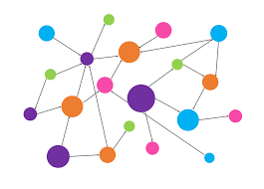
Step 1: Sampling Approaches
Edge: if two tuples satisfy at least one predicate
Construct Relational Data to Graph Structure
Node: tuple
Single-round sampling
Relational Tables $𝒟$
Graph G
Multi-round sampling
Run sampling k times and obtain k samples
Discover rules on k samples, respectively
Union k sets of rules
Address the issue of low recall caused by single-round sampling

Slide 14
Step 1: Sampling Approaches
Random walk strategy:
Randomly select a (len-1)-length path from a starting tuple.
Randomly pick a initial tuple t;
Iteratively sample more tuples by random walk. At each step, it terminates with probability $ε$ or moves to a neighbor of current vertex with $(1−ε)$ probability.
Loop Step 1 until sample size reaches.
Breadth-first search strategy:
Randomly select one tuple pair $(t_{0},t_{1})$ and select all (len-1)-hop neighborhoods of $t_{0}$ and $t_{1}$.
Loop Step 1 until sample size reaches.
Basic idea:
If $⟨t_{0},t_{1}⟩$contributes to an REEs $φ$ of len tuple variables, BFS ensures that at least one valuation of $φ$ is in $Neigh(t_{0},t_{1})$.

Slide 15
Step 1: Sampling Approaches
Theoretical Guarantee (BFS sampling)
Given a sampling ratio $r$, a recall bound $β$, a support bound$σ$, a confidence bound $η$, and a error constant $ε∈(0,1$), multi-round sampling with BFS strategy draws a set of $D_{s}$ of
$$k=\left\lceil lnε/\ln{(1−exp⁡(−\frac{β^{1−1/Δ}{\left(σ^{′}−σr^{2}β^{1−1/Δ}\right)}^{2}}{3σr^{2}}}))\right\rceil$$
with probability $(1−ε)$ such that
(1) $recall\left(Σ,Σ_{s}\right)≥β$, where $Σ$ and $Σ_{s}$ are the set of minimal rules on $D$and $D_{s}$, respectively;
(2) such REEs in $Σ_{s}$ can be discovered by setting $σ^{′}=\left\lceil {σr^{2}β}^{1/∆}+1\right\rceil$ and $η^{′}=\frac{1−ε/4}{1+ε/4}η$
BFS strategy makes sure that rules with multiple relational atoms can be discovered with a theoretical guarantee.

Slide 16
Step 2: Rule Discovery
Level-wise search algorithm
$$(∅, P_{all}, p_{0})$$
Issue 1: numerous attributes/tuples makes the level-wise algorithm slow
Issue 2: Mining rules on sampled data may result in the loss of certain constants
$$(P_{1},\left\{P_{all}\backslash P_{1}\right\},p_{0})$$
$$(P_{2},\left\{P_{all}\backslash P_{2}\right\},p_{0})$$
$$…$$
$$(P_{n},\left\{P_{all}\backslash P_{n}\right\},p_{0})$$
$$(P_{1}P_{2},\left\{P_{all}\backslash P_{1}P_{2}\right\},p_{0})$$
$$…$$
$$(P_{2}P_{n},\left\{P_{all}\backslash P_{2}P_{n}\right\},p_{0})$$
$$(P_{1}P_{2}P_{n},\left\{P_{all}\backslash P_{1}P_{2}P_{n}\right\},p_{0})$$
…
$$(P_{n−2}P_{n−1}P_{n},\left\{P_{all}\backslash P_{n−2}P_{n−1}P_{n}\right\},p_{0})$$
…
…
…
Triplets: $\left\{\left(P_{sel}, { P}_{re},{ p}_{0}\right)\right\}$ $=⇒$ candidate rules: $P_{sel}→$ $p_{0}$
$P_{sel}$: the set of predicates selected to constitute X;
$P_{re}$: the set of remaining predicates in $P_{all}$;

Slide 17
Step 2: Rule Discovery
Level-wise search algorithm
$$(∅, P_{all}, p_{0})$$
Issue 1: numerous attributes/tuples makes the level-wise algorithm slow
Issue 2: Mining rules on sampled data may result in the loss of certain constants
$$(P_{1},\left\{P_{all}\backslash P_{1}\right\},p_{0})$$
$$(P_{2},\left\{P_{all}\backslash P_{2}\right\},p_{0})$$
$$…$$
$$(P_{n},\left\{P_{all}\backslash P_{n}\right\},p_{0})$$
$$(P_{1}P_{2},\left\{P_{all}\backslash P_{1}P_{2}\right\},p_{0})$$
$$…$$
$$(P_{2}P_{n},\left\{P_{all}\backslash P_{2}P_{n}\right\},p_{0})$$
$$(P_{1}P_{2}P_{n},\left\{P_{all}\backslash P_{1}P_{2}P_{n}\right\},p_{0})$$
…
$$(P_{n−2}P_{n−1}P_{n},\left\{P_{all}\backslash P_{n−2}P_{n−1}P_{n}\right\},p_{0})$$
…
…
…
Triplets: $\left\{\left(P_{sel}, { P}_{re},{ p}_{0}\right)\right\}$ $=⇒$ candidate rules: $P_{sel}→$ $p_{0}$
$P_{sel}$: the set of predicates selected to constitute X;
$P_{re}$: the set of remaining predicates in $P_{all}$;

Slide 18
Step 2: Rule Discovery
Optimization Strategy 1: Dynamic Predicate Extension
Given${ 𝒫}_{sel}$, keep adding new predicate 𝑝, and checking whether${ 𝒫}_{sel}∪\left\{p\right\}→p_{0}$ is valid
Try all predicates 𝑝
Only consider predicates 𝑝 that are correlated with ${ 𝒫}_{sel}$amd $p_{0}$
AGENT
ENVIRONMENT
Using reinforcement learning，dynamically expand and learn predicate correlations, guiding pruning
Correlation model $M_{corr}$
Input：$𝒫_{sel}, p, p_{0}$
Output：$True/Fasle$

Slide 19
Step 2: Rule Discovery
Optimization Strategy 1: Dynamic Predicate Extension
action：next predicate p
DQN learns policy
by initially selecting a random predicate and continuously expanding to add new predicates
If $supp\left(𝒫_{sel}\right)<σ$or ${|𝒫}_{sel}∪\{p\}|$ exceeds the maximum length, set a very small negative reward
reward： $conf\left(𝒫_{sel}∪\{p\},p_{0}\right)−conf\left(𝒫_{sel},p_{0}\right)$
AGENT
ENVIRONMENT
1. The action set keeps narrowing down.
2. Represent predicates using bit vectors.
state：currently
selected $𝒫_{sel}$

Slide 20
Step 2: Rule Discovery
Optimization Strategy 1: Dynamic Predicate Extension
Randomly select a set of instances ${(𝒫}_{sel}→p_{0})$
Relational Data $𝒟$
Sampled Data $D_{s}$
Generate a small set of instances by DQN：${(𝒫}_{sel}→p_{0},0/1)$
Fine-tuning
AGENT
ENVIRONMENT
X₂
DQN Network
Guide Rule Discovery
Training instances：
$${(𝒫}_{sel}^{′}→p_{0},0/1)$$
X₁
Binary Classifier

Slide 21
Step 3: Constant Recovery
Level-wise search algorithm
$$(∅, P_{all}, p_{0})$$
Issue 1: numerous attributes/tuples makes the level-wise algorithm slow
Issue 2: Mining rules on sampled data may result in the loss of certain constants
$$(P_{1},\left\{P_{all}\backslash P_{1}\right\},p_{0})$$
$$(P_{2},\left\{P_{all}\backslash P_{2}\right\},p_{0})$$
$$…$$
$$(P_{n},\left\{P_{all}\backslash P_{n}\right\},p_{0})$$
$$(P_{1}P_{2},\left\{P_{all}\backslash P_{1}P_{2}\right\},p_{0})$$
$$…$$
$$(P_{2}P_{n},\left\{P_{all}\backslash P_{2}P_{n}\right\},p_{0})$$
$$(P_{1}P_{2}P_{n},\left\{P_{all}\backslash P_{1}P_{2}P_{n}\right\},p_{0})$$
…
$$(P_{n−2}P_{n−1}P_{n},\left\{P_{all}\backslash P_{n−2}P_{n−1}P_{n}\right\},p_{0})$$
…
…
…
Triplets: $\left\{\left(P_{sel}, { P}_{re},{ p}_{0}\right)\right\}$ $=⇒$ candidate rules: $P_{sel}→$ $p_{0}$
$P_{sel}$: the set of predicates selected to constitute X;
$P_{re}$: the set of remaining predicates in $P_{all}$;

Slide 22
Step 3: Constant Recovery
Optimization Strategy 2: Constant Recovery
Recover rules with constant predicates
Constant Template pattern $φ_{tem}:(P→Q,t_{tem})$
Steps：
Discover rules with constant template pattern;
Check tuples from $D$ that satisfy the non-constant predicates in these rules, and fill in the candidate constants to instantiate the wildcards in $φ_{tem}$
Valid newly obtained rules on entire data $D$
$$t_{tem}=(⊕_{1}.left,⊕_{2}.left,_{, ⊕}_{1}.right,⊕_{2}.right,\overline{_},≠,M||_)$$
Constant Recovery
Rule Discovery
$${ Σ}_{s}$$
$$Σ_{CR}$$
$$D$$
$$D_{s}$$
Sampling Approaches

Slide 23
Experimental Settings
Datasets
Name | Type | #tuple | #attributes | #relations
Airport | Real-life | 55,113 | 18 | 1
Hospital | Real-life | 114,919 | 15 | 1
Inspection | Real-life | 220,940 | 17 | 1
NCVoter | Real-life | 1,681,617 | 12 | 1
DBLP | Real-life | 1,799,559 | 18 | 3
Realty | Real-life | 642,257 | 110 | 12
Tax | synthetic | 10,000,000 | 15 | 1
Random sampling
Mine rules from entire $D$
No dynamic expansion
No constant recovery
Baselines
Variants：${PRMiner}_{RS}$、${PRMiner}_{full}$、${PRMiner}_{noml}$、${PRMiner}_{noCR}$
Baselines：$DCFinder$、$REEFinder$
Evaluation
Running Time, Precision, Recall
SOTA mine DCs
Extension of DCFinder
Notes:
Rules play a critical role in many aspects of data management

Slide 24
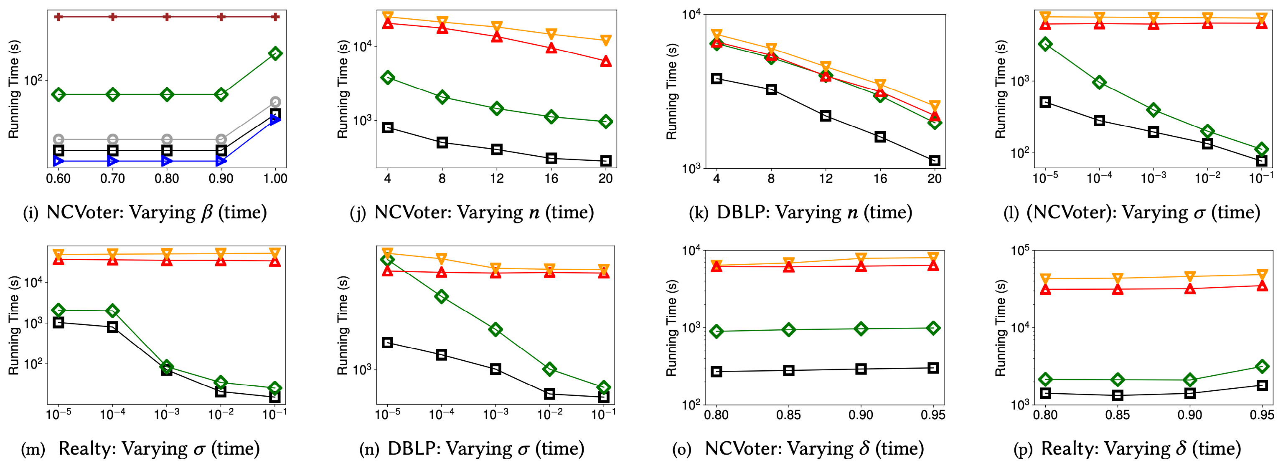
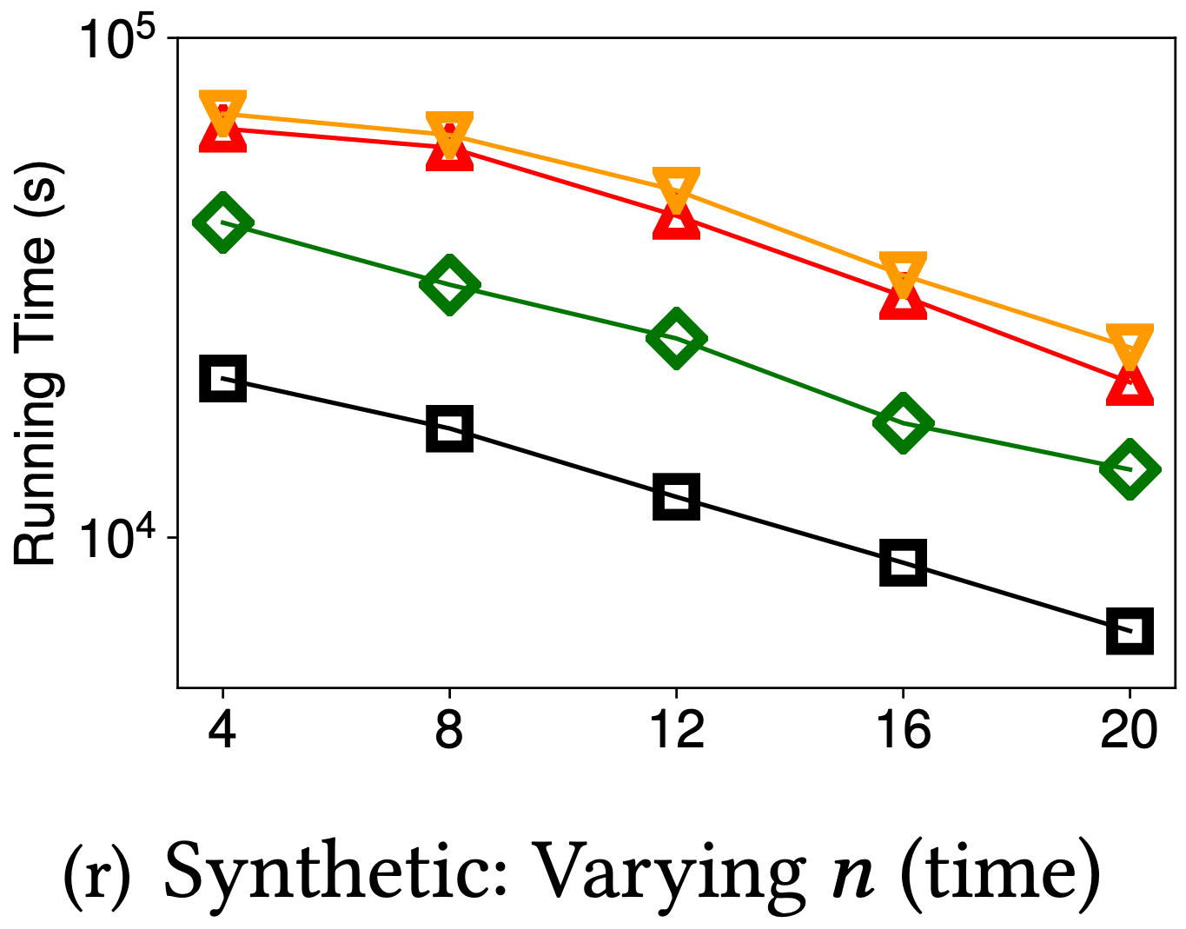
Exp-1: Running Time
When sample ratio is 10% and sample round is 2: PRMiner vs. ${PRMiner}_{full}$ speed up 12.2X on average;
Dynamic predicate expansion is effective: PRMiner $vs. {PRMiner}_{noml}$ speed up 2.52X on average, up to 4.77X;
On DBLP data, PRMiner vs. ${PRMiner}_{full}$ vs. DCFinder: 406s vs. 2960s vs. 3148s
Notes:
Rules play a critical role in many aspects of data management

Slide 25
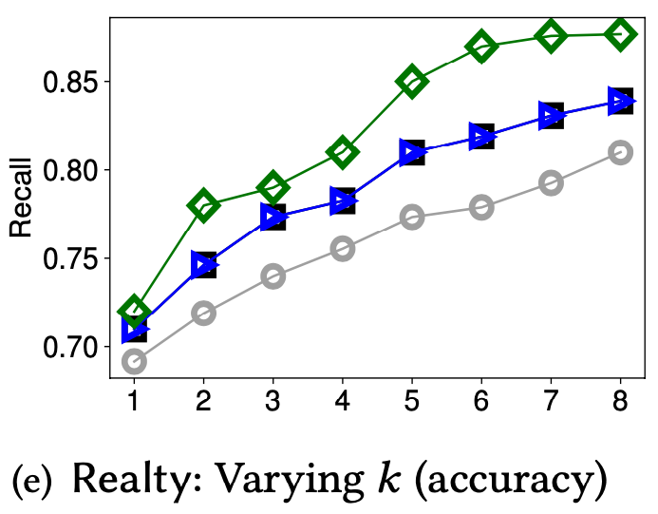
Exp-2: Precision/Recall
When sample ratio is $10\%$, the precision and recall of PRMiner is 90% and 82% (up to 93% and 85%), 2% and 13% higher than ${PRMiner}_{RS}$;
On Airport data, PRMiner vs. ${PRMiner}_{noCR}$ recall improve 2% on average;
The use of predicate correlation model $M_{corr}$ accelerates rule discovery without causing significant performance degradation, e.g., when sample ratio is 10% and sample round is 2, PRMiner $vs. {PRMiner}_{noml}$, precision and recall only decrease 1% and 2%.
Notes:
Rules play a critical role in many aspects of data management

Slide 26
Conclusions
We proposed a multi-round sampling strategy with accuracy guarantees.
We designed a rule discovery algorithm with the parallel scalability.
We designed an ML-based dynamic predicate expansion strategy to prune the search space.
We proposed a method to retrieve constant patterns.
Our experimental study verified that the above methods are promising.

